Slide 1
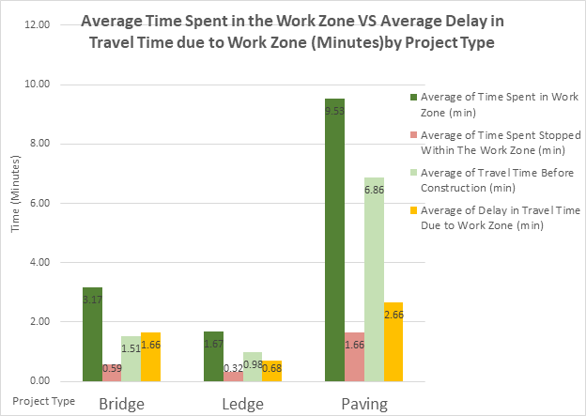
 | FACT SHEET
 | EDC-3 Smarter Work Zones
& STIC Annual Meeting
STIC PROJECT TITLE EDC-3 Smarter Work Zones STUDY TIMELINE 2013 -2017 PRINCIPAL CHAMPION Nancy Avery, TSMO VTRANS CONTACT(S) Nancy Avery Work Zone Traffic Management Engineer This fact sheet was prepared for the 2017 VTrans Research Symposium & STIC Annual Meeting held on September 28, 2017 at National Life in Montpelier, VT. 8:00 am– 12:00 pm. Fact sheets can be found for additional projects featured at the 2017 Symposium at http://vtrans.vermont.gov/planning/research/2017symposium Additional information about the VTrans Research Program can be found at http://vtrans.vermont.gov/planning/research Additional information about the VTrans STIC Program can be found at http://vtrans.vermont.gov/boards-councils/stic | Introduction to the Proposal. To provide effective traffic management during construction to minimize travel delays and provide speed management by incorporating Smarter Work Zone tools to more Agency projects. Methodology or What was done? The Agency has instituted on a few of our larger projects with higher traffic volumes the use of Smart Work Zone Intelligent Transportations Systems to evaluate traffic delays and vehicle speeds. I-91 Brattleboro (2013-2017) I-89 Waterbury (2015-2016) I-91 Hartland (2016) I-89 South Burlington (2016-2017) I-91 Rockingham (2017-2018) Also quantifying the “10 Minute Work Zone Delay Rule” was evaluated with active construction project for the 2017 season to verify if Agency projects are able to achieve this specification. Conclusion or What are the next steps? Review the data collected to develop protocols and procedures as to when and where to include IT systems into Agency projects. What are potential impacts? What is the benefit to VTrans? Reviewing the data from these specific projects will assist with minimizing travel delays and managing speeds resulting in reducing construction time while providing safer mobility for the public
2017 Research
Symposium

